Slide 1
Control Charts-based Trading Strategies for Cryptocurrency and Stock indices
Course: Data Analytics and Systems Monitoring
Weihang Ren Babak Ahmadi

Slide 2
Structure of Presentation:
1. Problem
2. Literature (What has been done in this field)
3. Explanation of Methods: Explain-Justify-Necessary technical details
return / price(Residual-based CUSUM, using ARIMA to handle autocorrelation)
a) CUSUM
Montgomery or literature CUSUM
ii) finding best k and h for each coin using grid search
iii) risk-adjusted CUSUM on stock price
b) EWMA
4. Results
Explain data/examples
describe observed results
Res. Back test (all profits and everything)
Res. risk-adjusted CUSUM for stock prices
plots and tables to compare
5. Summary of findings and insights:
main conclusion
strength and shortage of the applied method
applicational insights
recommendations
2/29

Slide 3
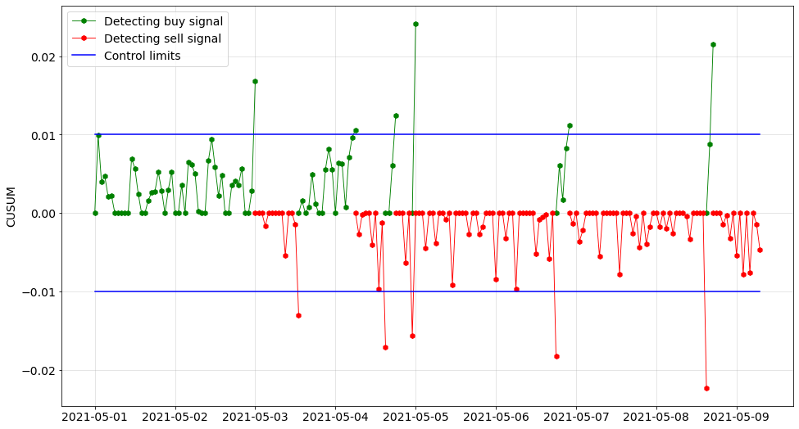



Is it possible to determine some strategies by control charts to trade and make profit? If yes, which control chart or method works the best? Our focus is on Application of Control Charts in Cryptocurrency and stock prices.
Problem
3/29

Slide 4
Motivation for Cryptocurrency: Cryptocurrency is one of the most controversial topics nowadays and we want to see if we can use the control charts to make profit in this market.
Problem
Motivation for risk-adjusted CUSUM:
By applying risk adjusted monitoring method, we try to reveal factors that affect the stock price which is exclusive to the company instead of the whole industry.
Better than fundamental analysis
3/29

Slide 5
Literature
Paper | Main Focus/ Idea/ Methods | Connections/Differences | Comments
Roberts HV. Stock-market “patterns” and financial analysis: methodological suggestions. J Finance. 1959;14(1):1-10. | First paper that used SPC methods to study changes in stock market price levels. | No trading rules | Set up control limits to aid visualize analysis in the future. If a point falls outside the control limits, this gives a signal for analyst.
Hubbard CL. A control chart for postwar stock price levels. Finance Anal J. 1967;23(6):139-145. | Determined stock price trend and compared it with gross national product (GNP) and personal income trends. Set up decision rules for buying or holding stocks. | Proposed a decision rule based on sell and buy signals. | The used data is monthly values of 200 stock average from 1950 to 1967.
Alexander SS. Price movements in speculative markets: trends or random walks. Ind Manag Rev. 1961;2(2):7-26. 43. Alexander SS. Price movements in speculative markets-trends or random walks, number 2. Ind Manage Rev. 1964;5(2):25–46. | Introduced the filter trading rules. Filter trading rule is defined as a sequence of signals for buying and selling stocks. Buy signal: for example, the daily closing price of a stock moves up at least a certain percent x from a subsequent low. x here is the filter size for the trading rule. | Calculated profits from various filter sizes and compared them with buy and hold strategy. | Findings in these papers can be summarized as: Price changes appear to follow a random walk over time, but a move, once initiated, tends to persist.

Slide 6
Literature
Paper | Main Focus/ Idea/ Methods | Connections/Differences | Comments
Lam K, Yam H. CUSUM techniques for technical trading in financial markets. Finadndc Eng Jpn Markets. 1997;4(3):257-274. | Motivated by the filter trading rule, used CUSUM to create a trading strategy (equivalent to filter trading rule) in the stock market. a) k=0, h=log(1+x) x: filter size of trading rule= b) Then generalized the classical filter trading rule: k≠0 First, they considered general CUSUM procedure (k>0, h=0) | First Trading Strategy based on CUSUM method. Worked on different scenarios for k and h. | Main drawback of the general filter trading rule (k>0, h=0): Absence of a stop-loss mechanism.
YiG,Coleman S, RenQ. CUSUM method in predicting regime shifts and its performance in different stock markets allowing for transaction fees. J Appl Stat. 2006;33(7):647-661. | CUSUM techniques in predicting regime shifts (between bullish and bearish) + transaction fees. Performance of each k and h is measured by Total Profit and Daily Profit. | Considering transaction fees in contrast with Lam, Yam. For the first time in CUSUM papers. | Result of considering transaction fees was Deterioration of CUSUM (No acceptable k and h)

Slide 7
Problem
In this project, we want to directly derive multiple trading strategies based on different control charts, including CUSUM, EWMA, and their variants.
Also propose an innovative way that applies a risk-adjusted control chart to the trading strategy
(Adjust biomedical company stock price by biotech indices)

Slide 8
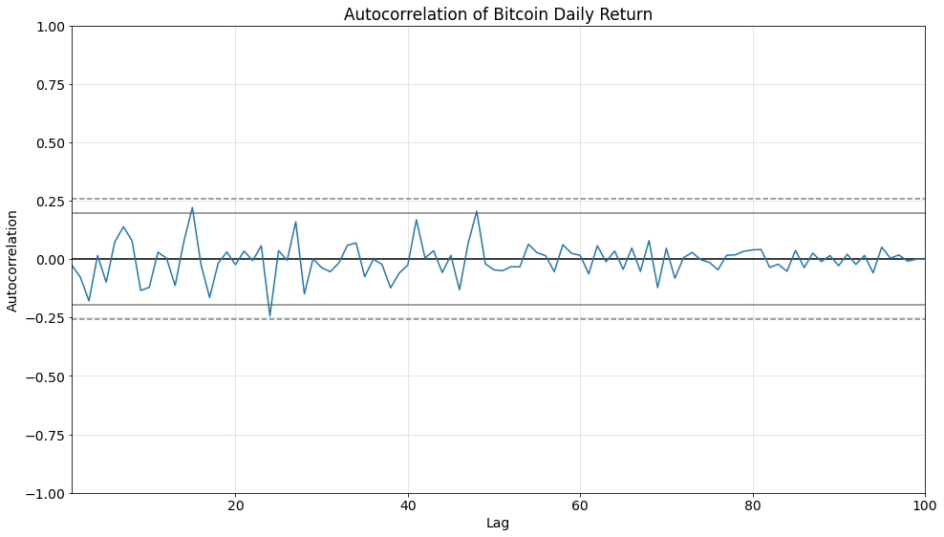
1. Calculate and use Return of each coin, which is not auto-correlated.
Methods
Deal with Auto-correlated data

Slide 9
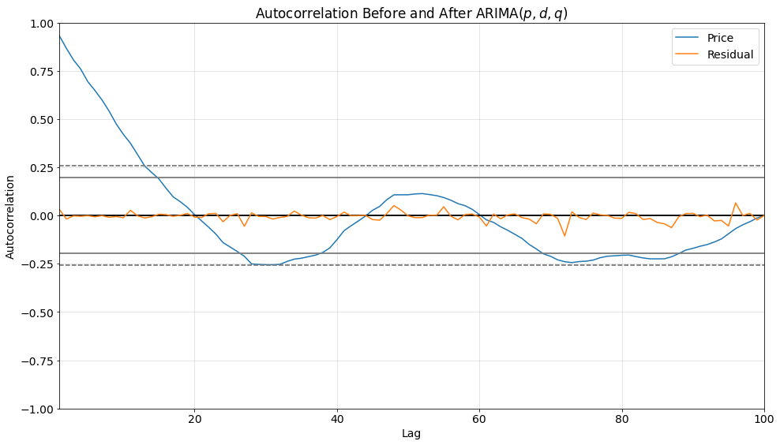
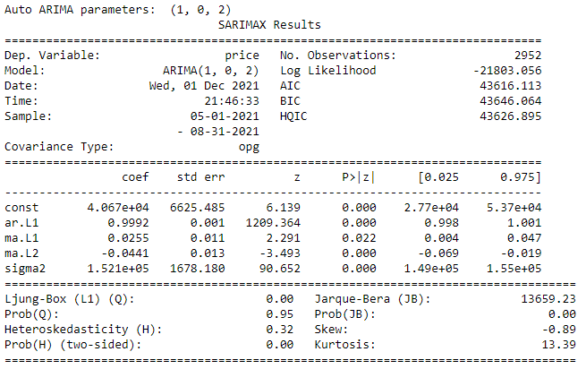
Deal with Auto-correlated data
Methods
2. Another procedure we use to deal with this auto-correlated data is using ARIMA. Find the best AR and MA parameters for our case. Implement CUSUM model on the residuals. (Residual-based CUSUM). Auto ARIMA takes into account the AIC and BIC values generated to determine the best combination of parameters. AIC (Akaike Information Criterion) and BIC (Bayesian Information Criterion) values are estimators to compare models. The lower these values, the better is the model.

Slide 10
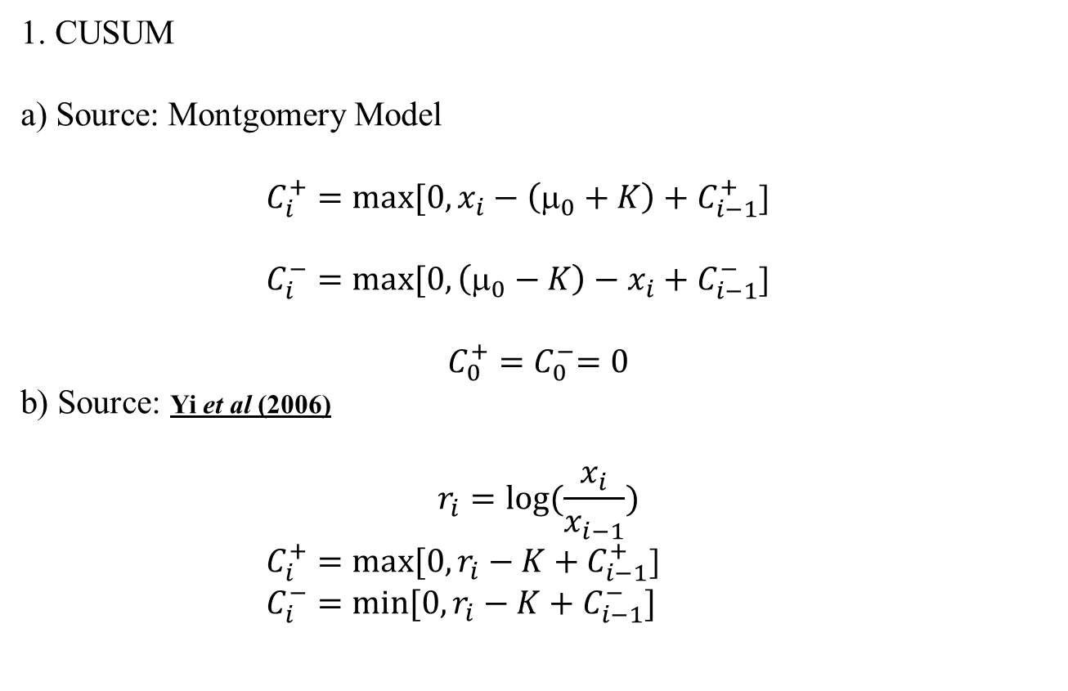
1. CUSUM a) Source: Montgomery Model $C_{i}^{+}=max⁡[0, x_{i}−\left(μ_{0}+K\right)+C_{i−1}^{+}$] $C_{i}^{−}=max⁡[0,\left(μ_{0}−K\right)−x_{i}+C_{i−1}^{−}$] $$C_{0}^{+}{=C}_{0}^{−}=0$$ b) Source: Yi et al (2006) $$r_{i}=log⁡(\frac{x_{i}}{x_{i−1}})$$ $C_{i}^{+}=max⁡[0,r_{i}−K+C_{i−1}^{+}$] $C_{i}^{−}=\min{[0,r_{i}−K+C_{i−1}^{−}]}$
Methods

Slide 11
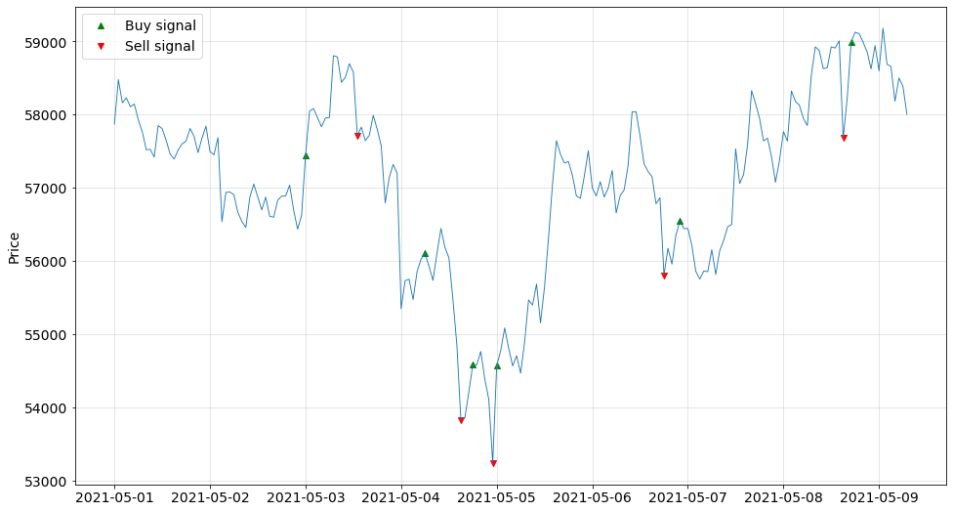

Slide 12
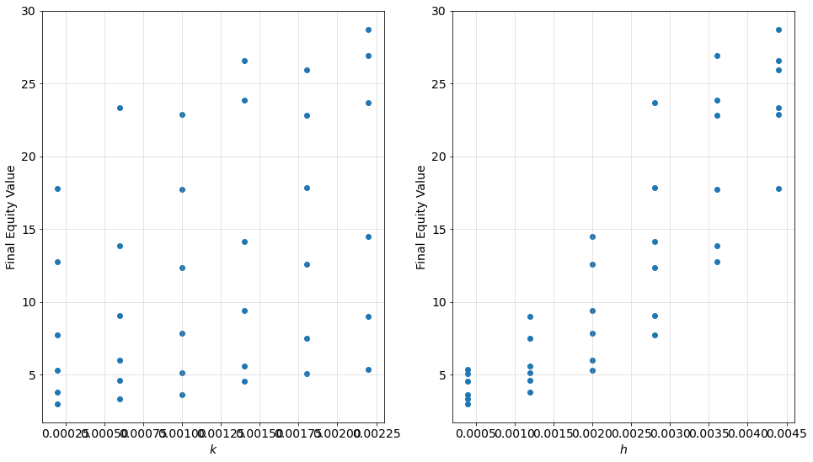
K and h Values To find the best trading strategy, we use grid search for different pairs of k and h values. We compare the investment returns of each (k, h) and then we can present the best k and h for each method.
Methods

Slide 13
Most of the papers did not consider the transaction fees in their model, but to be more realistic, we consider transaction fees which is currently 0.5% of each buying transaction. We add this transaction fees to our models and compare the profits we make with and without it in Results. (Return as feature, Montgomery Model for CUSUM)
Methods
Transaction fees:
Transaction fee in reality:
Coinbase pricing and fees disclosures: 0.50%
https://help.coinbase.com/en/coinbase/trading-and-funding/pricing-and-fees/fees#
https://help.coinbase.com/en/pro/trading-and-funding/trading-rules-and-fees/fees

Slide 14
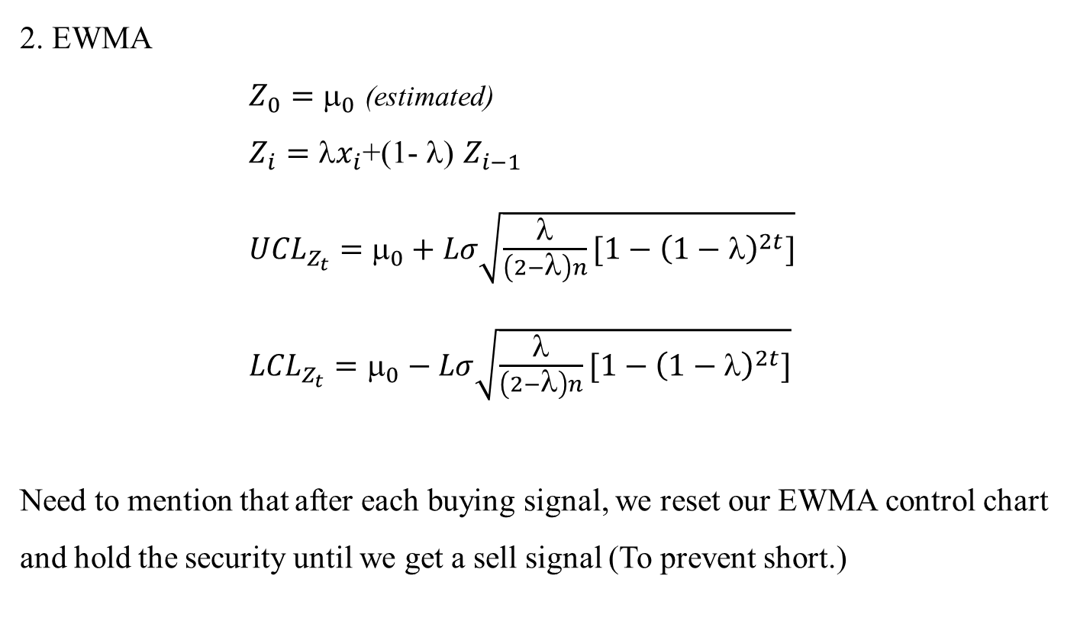
2. EWMA $Z_{0}=$ $_{0}$ (estimated) $Z_{i}=x_{i}$+(1- $$) $Z_{i−1}$ ${UCL}_{Z_{t}}=$ $_{0}+Lσ\sqrt{\frac{λ}{\left(2−λ\right)n}[1−{\left(1−λ\right)}^{2t}]}$ ${LCL}_{Z_{t}}=$ $_{0}−Lσ\sqrt{\frac{λ}{\left(2−λ\right)n}[1−{\left(1−λ\right)}^{2t}]}$ Need to mention that after each buying signal, we reset our EWMA control chart and hold the security until we get a sell signal (To prevent short.)
Methods

Slide 15
Why not risk-adjusted on Cryptocurrency? Unlike cryptocurrencies, stocks are directly linked to companies under regulatory surveillance. Investors can potentially use the information on the company and industry to reduce the risk of volatility. Risk-adjusted CUSUM for stock market ➔ Adjust biomedical company stock price by industry trend to reveal the real operations performance of the company.
Methods
Linearly regress BioTech company stock on its industry indices. Apply CUSUM to the residuals.

Slide 16
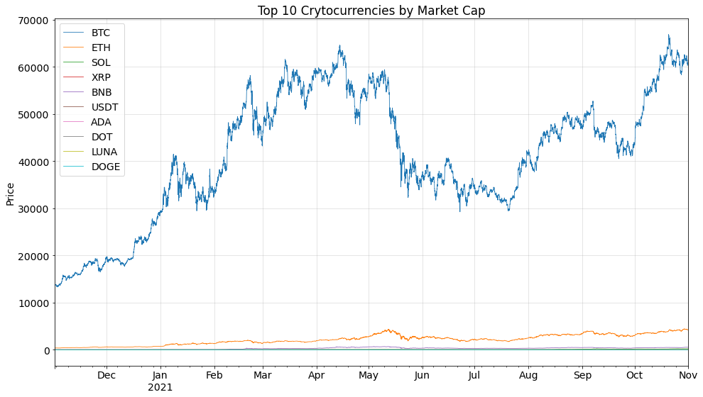

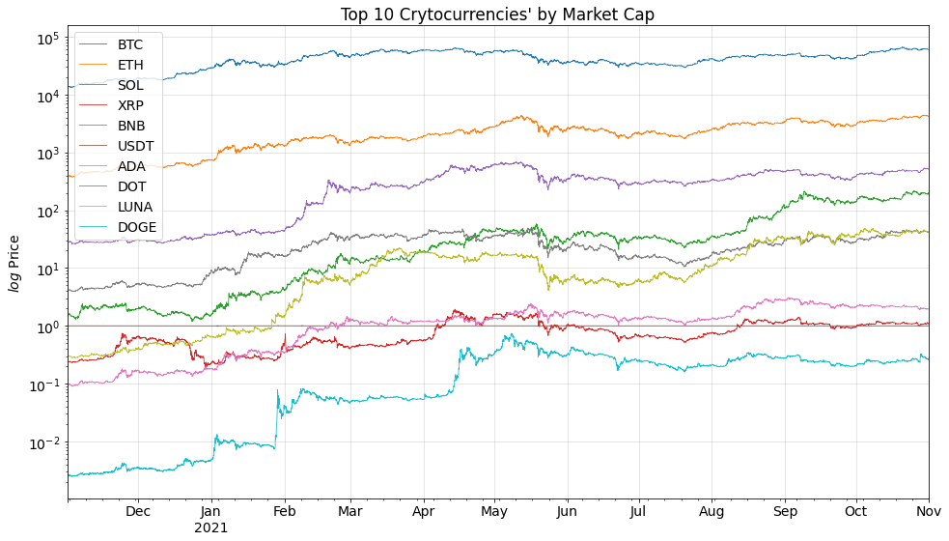
Data
In this project we use two data:
Historical hourly crypto price for top 9 Coins (Ranked by market cap)+Dogecoin for six months.

Slide 17
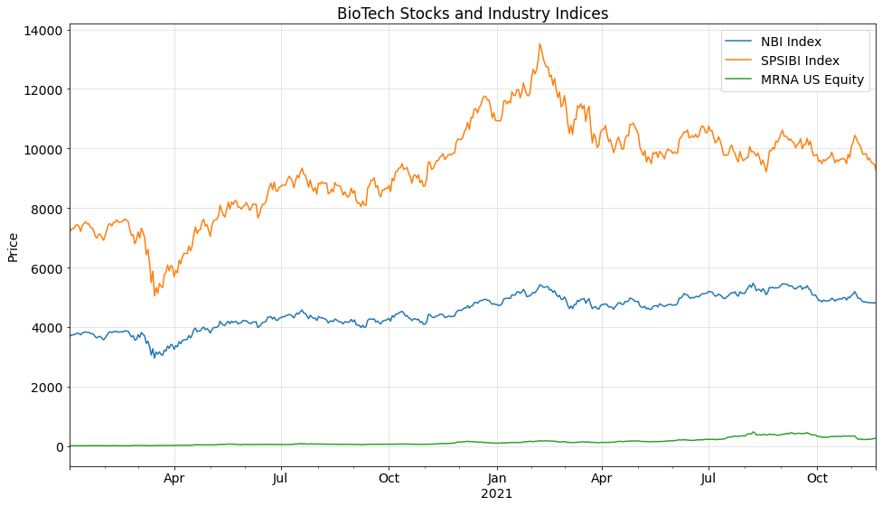
Data
2. Biotech Stock Market data is brought from Bloomberg:
Indices
DJI Index: Dow Jones Industrial Average. 30 prominent companies listed on stock exchanges in the United States.
SPX Index: Standard and Poor's 500. 500 large companies listed on stock exchanges in the United States.
NBI Index: NASDAQ Biotechnology Index. 213 Biotechnology or the Pharmaceutical industry companies listed on NASDAQ.
SPSIBI Index: S&P Biotechnology Select Industry Index. The biotechnology sub-industry portion of the S&P Total Markets Index (S&P TMI).
US Equities
PFE US Equity: Pfizer Inc. American multinational pharmaceutical and biotechnology corporation headquartered on 42nd Street in Manhattan, New York City.
MRNA US Equity: Moderna Inc. Pharmaceutical and biotechnology company based in Cambridge, Massachusetts that focuses on RNA therapeutics, primarily mRNA vaccines.
JNJ US Equity: Johnson & Johnson. Consumer Health, Pharmaceutical, and Medical Devices.

Slide 18
Results Structure
1. CUSUM
a) Return
i. Montgomery CUSUM Model
This is the only case we compare w/wo Transaction Fees
ii. Literature CUSUM Model
b) Price/Residual based CUSUM (Handle autocorrelation with ARIMA):
i. Montgomery CUSUM Model
ii. Literature CUSUM Model
2. EWMA
a) Return
b) Price/Residual based EWMA (Handle autocorrelation with ARIMA)
3. Risk-adjusted CUSUM for stock market data
4. Back test
To be completely realistic, Transaction Fee is considered unless stated otherwise.

Slide 19
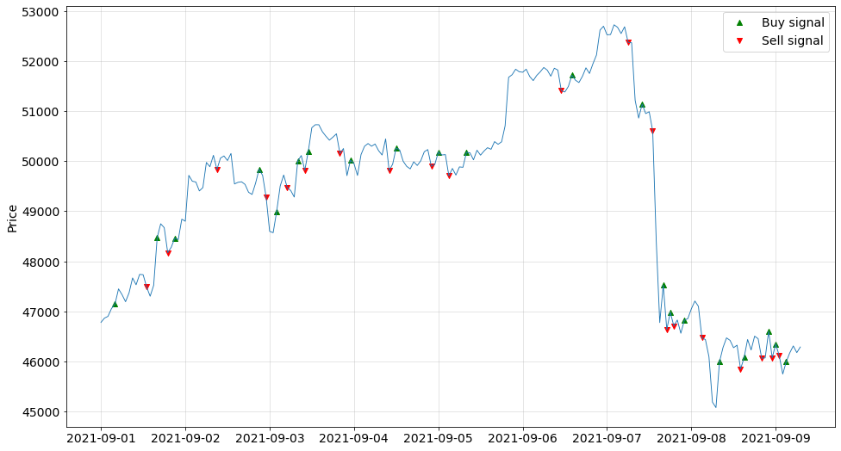
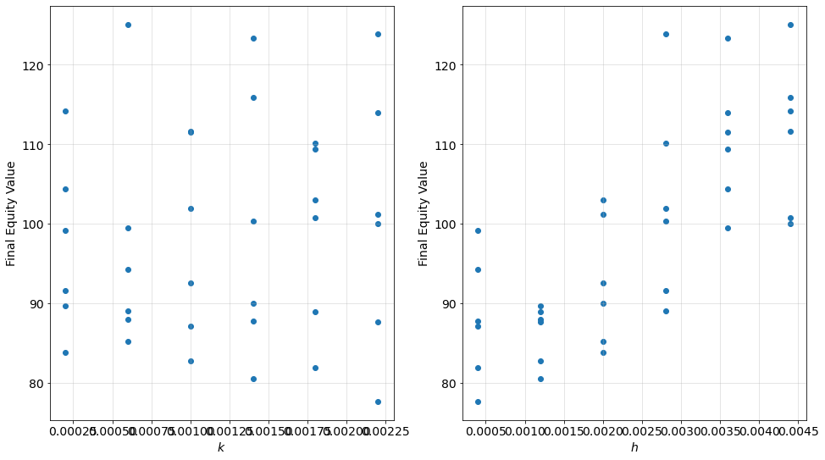
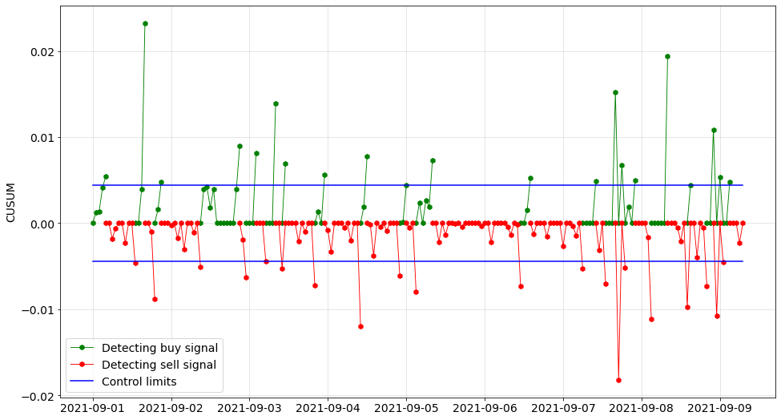
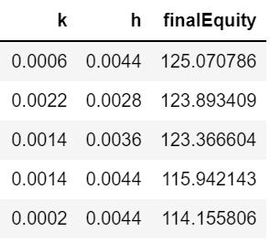
Results
1-a-i. CUSUM Method
Based on Return feature
Montgomery model
Without Transaction fees

Slide 20
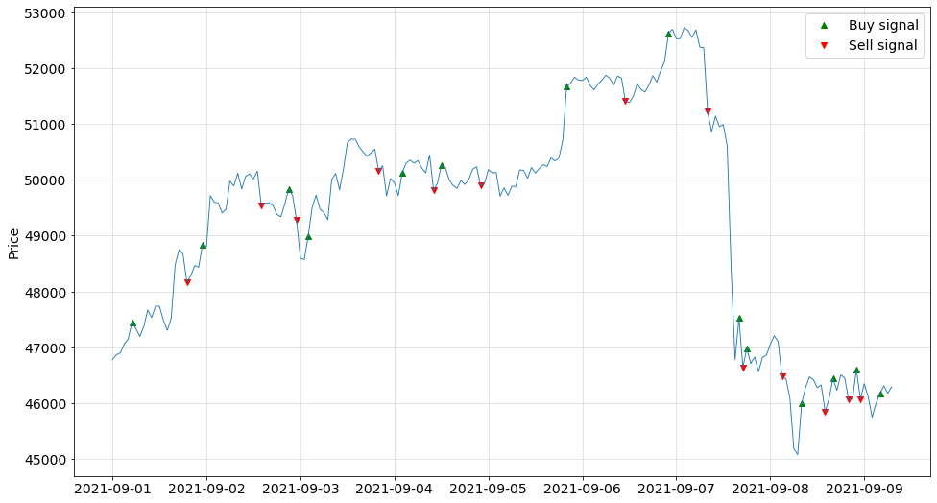
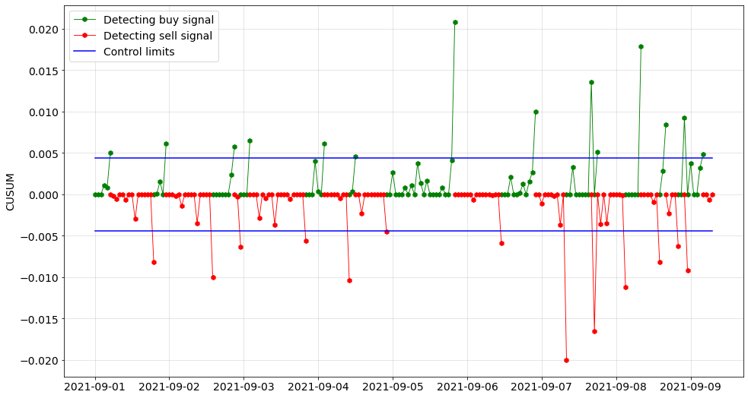
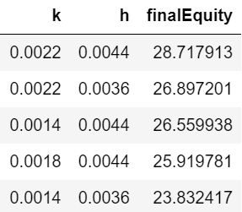
1-a-i. CUSUM Method
Based on Return feature
Montgomery model
With Transaction fees
Transaction Fee = %0.5

Slide 21
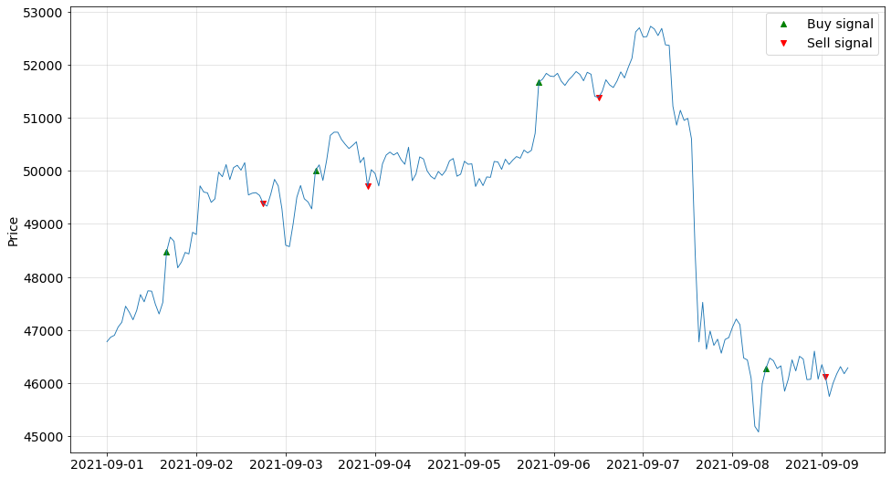
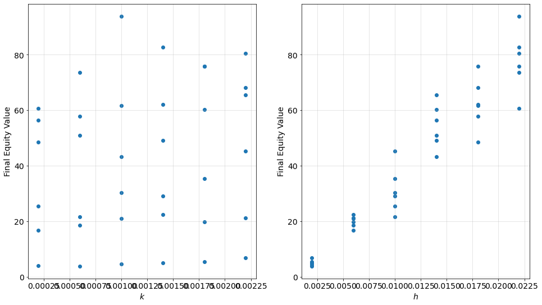
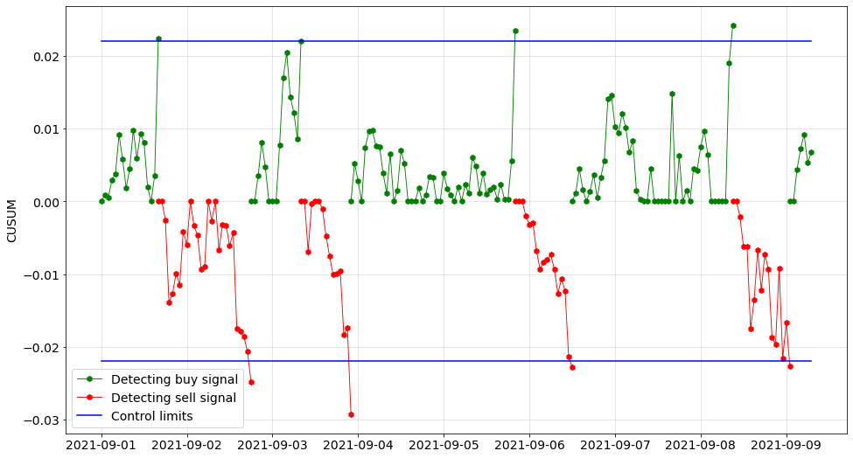
Results
1-a-ii. CUSUM Method
Based on Return feature
Literature model

Slide 22

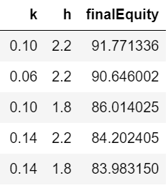
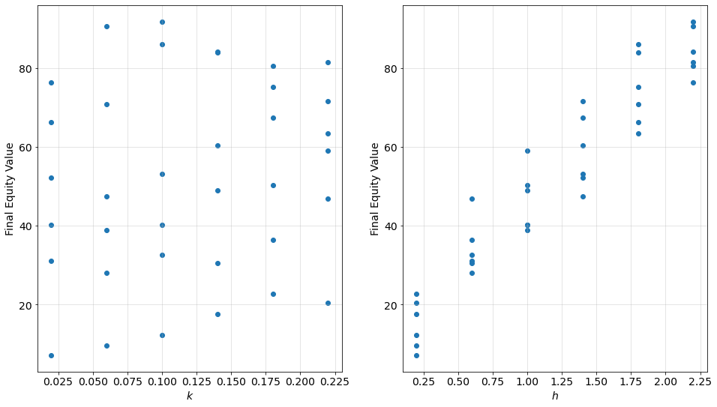
Results
1-b-i. CUSUM Method
Based on Residuals feature
(Residual Based CUSUM)
Montgomery model

Slide 23
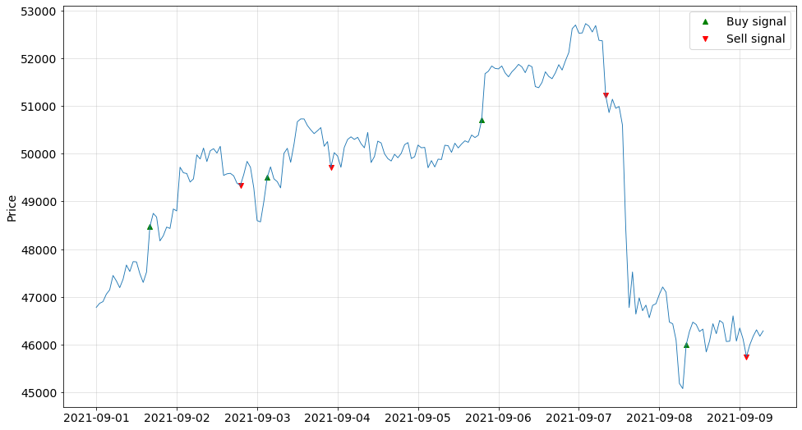
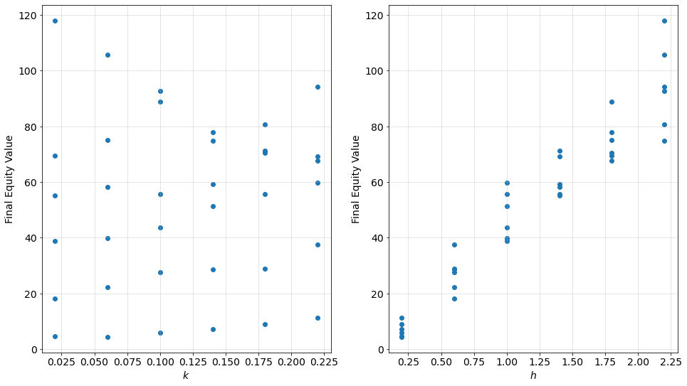
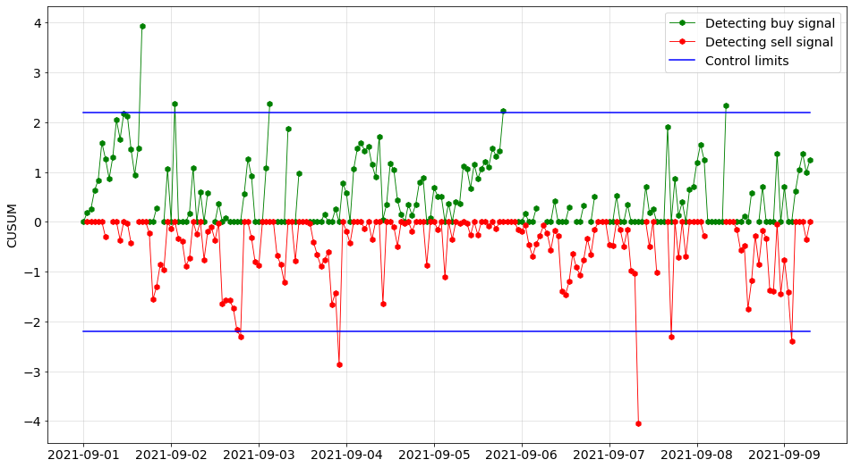
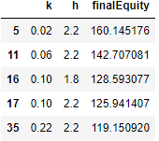
Results
1-b-ii. CUSUM Method
Based on Residuals feature
(Residual Based CUSUM)
Literature model

Slide 24
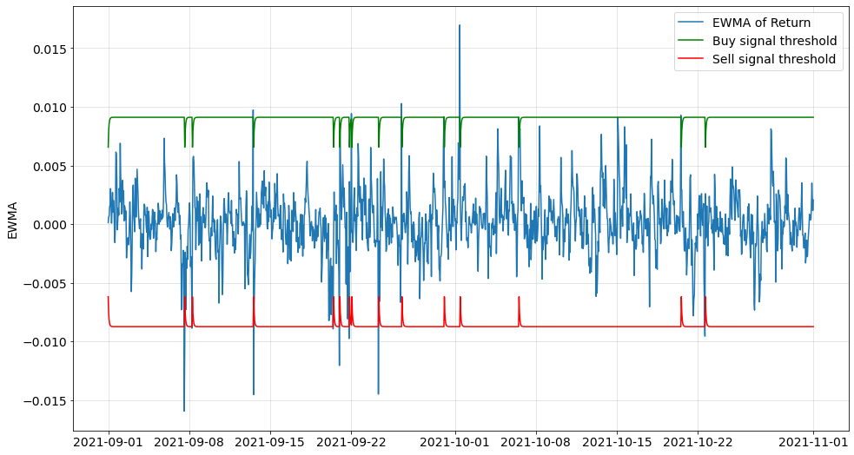
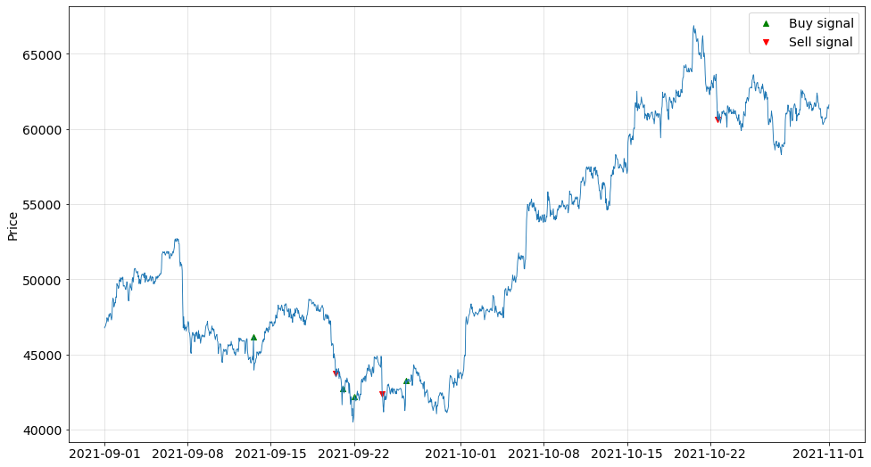
Results
2.a) EWMA Method
Based on Return feature

Slide 25
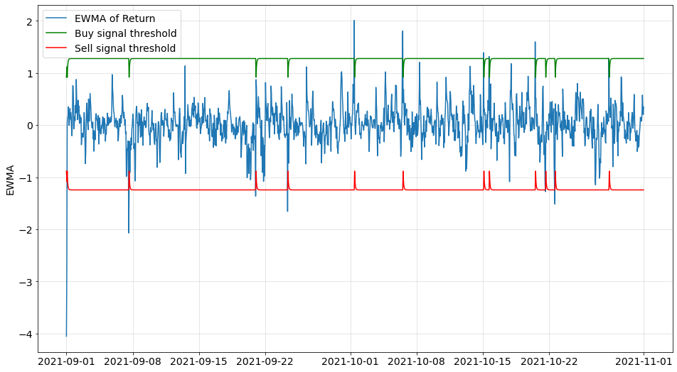
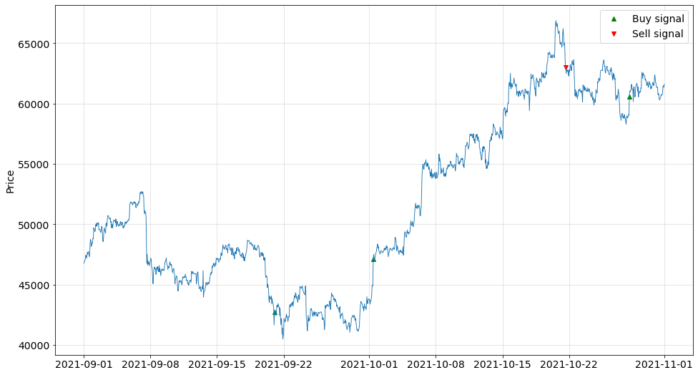
Results
2.b) EWMA Method
Based on Residuals feature
(Residual based EWMA)

Slide 26
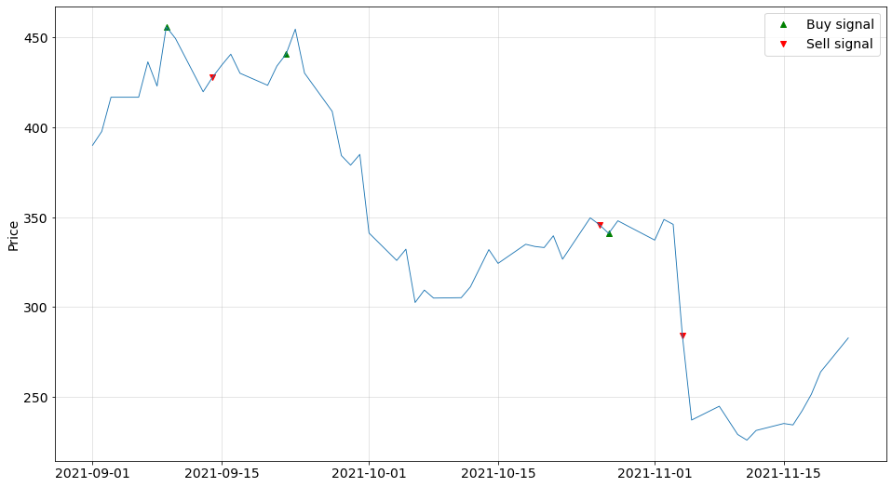
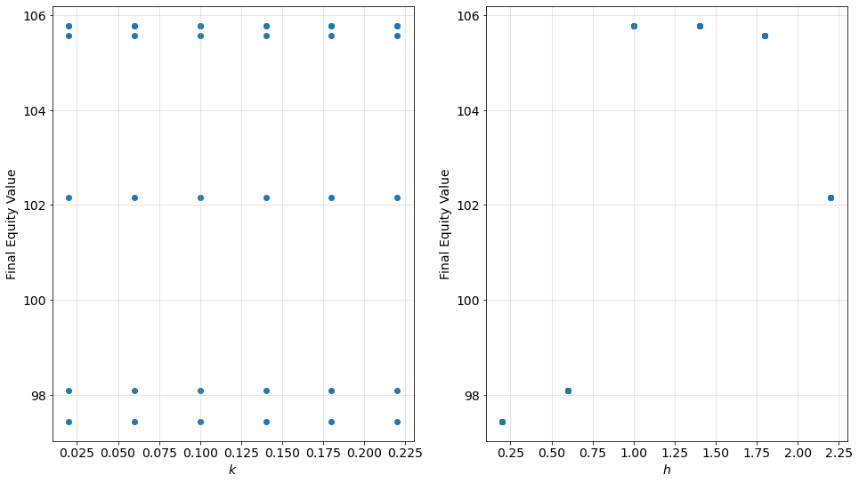
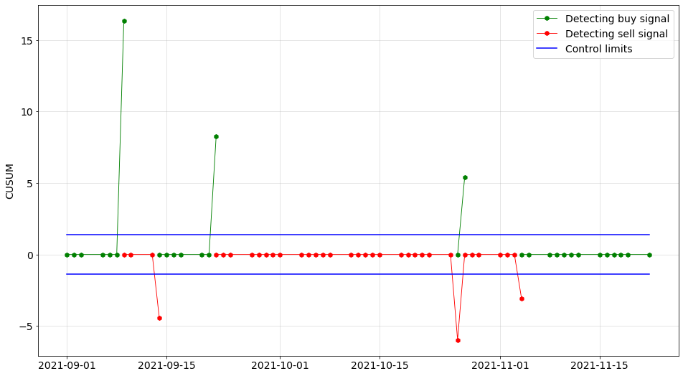
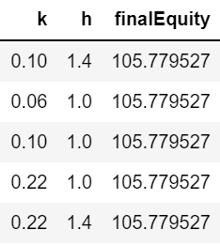
Results
3. Risk adjusted CUSUM
Stock Market Data

Slide 27
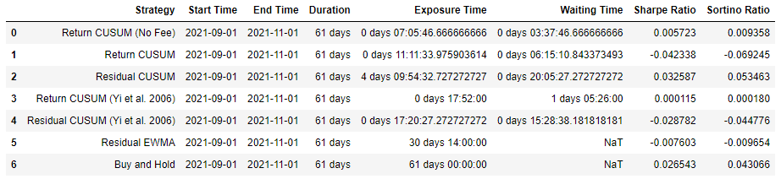
Results
4. Back test:
Ratio Table (ARL):
Average Exposure Time: ARL for sell signal
Average Waiting Time: ARL for buy signal
Sharpe Ratio: Risk adjusted return (Extra return on holding a risky asset)
Sortino Ratio: Downside risk adjusted return (Better indicator)

Slide 28
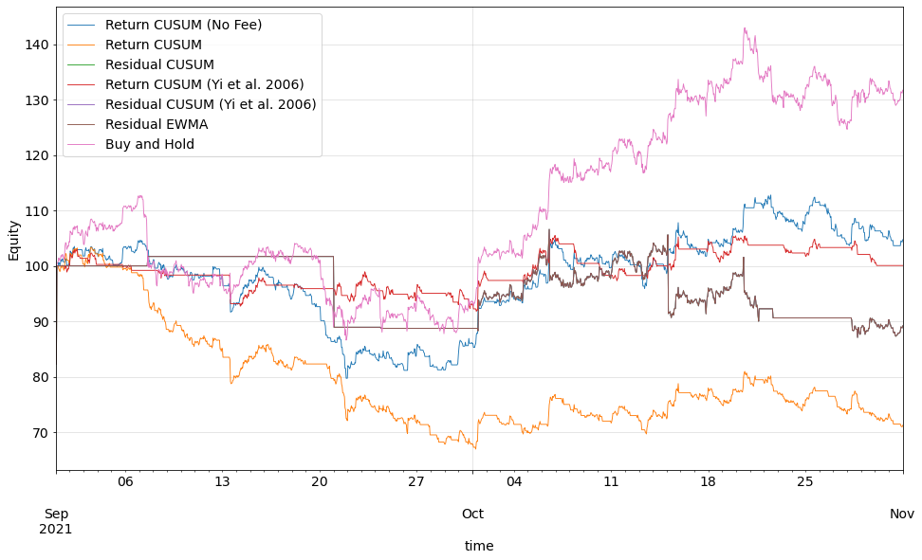
Results
4. Back test:
Equity Plot:

Slide 29
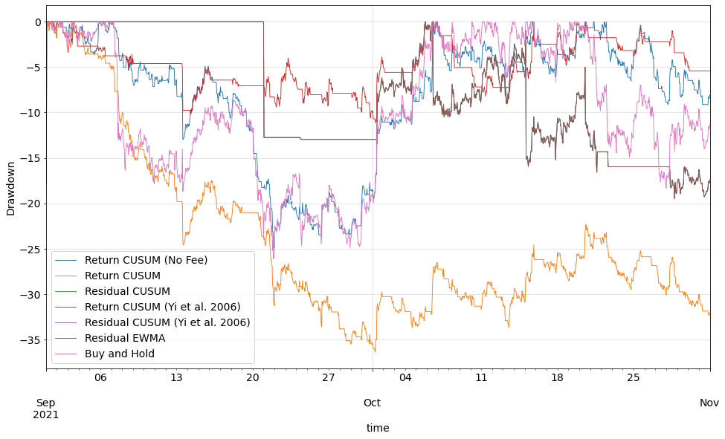
Results
4. Back test:
Drawdown plot:
➔ Return CUSUM (No Fee) and Return CUSUM (Yi et al. 2006) has better performance for risk-avoiders.

Slide 30
1. Main Conclusion: a) Control chart-based strategies can be profitable, and significantly reduce the risk while holding the asset. b) Residual-based CUSUM outperformed the benchmark in excess return. 2. Strength and Shortage of applied method: a) We developed a fully automated API to test for best control chart based trading strategy for given coin. b) Our results outperformed benchmark in key risk factors. c) First time applied these methods to cryptocurrency market. d) Innovative way of applying risk-adjusted chart for industry trend. e) h is symmetric in our study. In real market, asymmetric limits may be used. f) Transaction cost structure is oversimplified in our model.
Findings

Slide 31
3. Applicational insights: Do transaction fees always lead to loss? No. CUSUM can still work by increasing k, h, which means reducing trading frequency and making profit. insights: transaction fee affects a lot! In reality, transaction fee is much more complicated than a fixed rate. Future work can apply more complex transaction and management fee structure in order to achieve a better strategy using control charts. 4. Recommendations for future work: Generalization of k and h for a single method and different coins. Search for better lambda for EWMA strategies. Integrate more complex transaction cost considerations. Test in emerging markets and other markets for broader application.
Findings

